Slide 1
Byungtae Lee with Sung Joo Park College of Business, KAIST Prepared for AABPS2012 Annual Meeting
Coping with Faculty Shortage: Collaborative Faculty Exchange

Slide 2
Session Agenda
Moderator: Hirokazu Kono (Keio)
Keynote: Byungtae Lee (KAIST)
Why do we need collaborative faculty exchange?
Panels:
Michikazu AOI (Meiji)
Xiongwen LU (Fudan)
Ricardo LIM (AIM)
Discussion and Conclusion: Hirokazu Kono

Slide 4
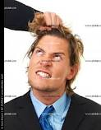
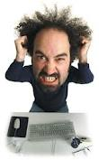
What pulls a Dean’s hair in Faculty Development?
Business School is A people-business
Competitive HR are defined by
Rankings,,…
Accreditation standards
Globalization of businesses
Economics of business schools
Mission and roles of business school
Role migration along faculty life cycle
New demands from business – ever expanding scope

Slide 5
How deans see faculty members

Slide 6
Deans need Inspector-Gadgets: Where are they?

Slide 7
Crumbling Core Faculty Development Models
Traditional US Model
Tenure system based
Market based
Traditional Asian Model
Hiring is tenure evaluation
Inbreeding or Captive market
Seniority based
Big Cherry Picking Model
Contract Based
IMD, INSEAD, IE…
Executive Education Oriented

Slide 8
Business Faculty Shortage
Global Issue but Severer in Asia
Faculty Shortage in U.S.: AACSB Prediction
2,500 by 2013
Solutions
Bridge Program: Non-Business PhDs
Ph.D. Program
Adjunct Professorship: PQ (Professionally Qualified)
Asian Business Schools?
No Statistics Available
Chronic Problem
Problems of Quantity and Quality

Slide 9
Why do we have the severer faculty shortage in Asia?
Very Few Supply Pipeline
Very Few Qualified PhD Programs
Busy for MBAs: Doing More Business than Academics
Competitive Disadvantage: Money and Brand
People’s Preference: Living and Learning in America!
Winner-Takes-All: Polarization
Compensation Difference
Total Benefits: Net income with extra compensation may be a different story
Earlier Retirement
Over-regulations
Economies of Scale and Scope – Need Community

Slide 10
Comparison of Retirement Age
Retirement System
65 (originally 70) by Otto Von Bismarck in 1883
Life Expectancy: Less than 45 in 1890
U.S.
No Mandatory Retirement
Voluntary Retirement Age: 75 on Average (Business Professor)
Asia
Korea: 65
Japan: 65
China: 65
Other Countries: ?
Teaching Career: 25-30 Years
Asian business schools have 20-25% less faculty manpower than U.S. due to the earlier retirement age.

Slide 11
Evolution of Business Education
Economic Growth
Management Science
O.R.
MIS
OM
Supply Chain
Accounting
HRM
Organization
Innovation
Strategy
Marketing
Finance
Ethics
Book Keeping
Agricultural
Economy
Industrial
Economy
Knowledge
Economy
Agriculture
Manufacturing
Service

Slide 12
Soft Skills Require Experiences
HRM
Organization, Corporate Governance
Innovation
Strategy, Leadership
Marketing
Information Systems
Operations Management
Finance
Accounting
Soft
Hard

Slide 13
Management+ Technology+ Liberal Arts

Slide 14
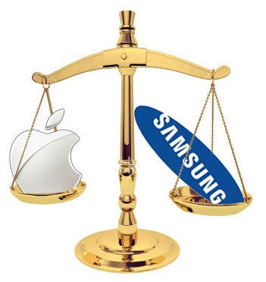
Battles in Courts or Markets?

Slide 15
And Now, + Laws+Design+…..

Slide 16
We have tried all …
Options
Utilizing Corporate Executives
Hiring Government Officers
Faculty Development from (Internal and External) Retired Scholars (Cream Skimming)
Visiting Scholars - Unpredictability
Leveraging PhDs and Post-docs
Online Education
Evaluate Alternatives by
Cost
Risk
Quality
Time and Availability

Slide 17
The Best Solution?
Impossible or near-impossible by an Individual School
Only Very Few Schools Can Afford
Through Collaboration
AAPBS can be a platform of collaborative faculty exchange
Collaborative Faculty Exchange

Slide 18
Collaborative Faculty Exchange (CFE) Project
Professor Market Place
Short-term Visit
One week seminar
One month short course
Longer-term Visit
One Semester
Half/One Year Stay: Asian Sabbatical Year
Volunteer Program: Help Our Friends
Help Asian Business Schools in Under Developed Countries
Teach Fishing than Giving Fish
Volunteer–based Collaboration
External Funding Source:
Seek ADB Funding
Official Development Assistance (ODA) Fund of Each Country
Senior Contribution Program: Leveraging Retired but Active Faculty
Recruiting Retired Faculty Member for Teaching/Research
Senior or Retired Faculty Members move to AAPBS Business Schools in Different Countries

Slide 19
Issues of CFE
Funding
External Funding
School Sponsor
Basic Salary, Insurance (Health), Campus (School) Housing
Quality
English Teaching Experience
Regular Faculty Members from Accredited Schools: AACSB, efmd
Recommendation on Quality Teaching by Dean
Teaching Evaluation Score
Coordinating Entity
CFE Committee under AAPBS
AAPBS Secretariat as an Administrative Body
Setting & Manage Home Page for Professor Marketplace
Match-making Administration

Slide 20
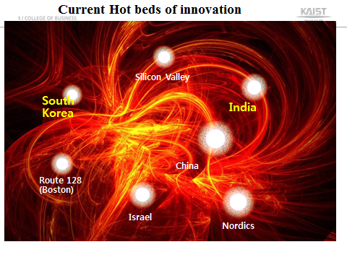
Why within or around AAPBS?
Have Seen Economic Developments
Asian countries in different economic stage require different fields of expertise in business education
Understand Cultural Issue Better
Cost Savings from Geographical Distances
Local Contexts: Asian vs. Western Style of Management
Question on the universality of business education
‘What’ is Universal but ‘How’ is not Universal

Slide 21
KCB also wishes our proudest EMBA alumni’s
&

