Slide 1
Guide to Using
MYIBS
Online Course Repository System using Claroline
For IBS Students Only

Slide 2
INTRODUCTION
Claroline is a basic / no-frill online open source course repository system.
This document is a quick user guide to Claroline.
Use the following link :
http://www.ibs.utm.my/myibs (from this slide onward, the image may show other URL but use this link only to access MYIBS e-learning)

Slide 3
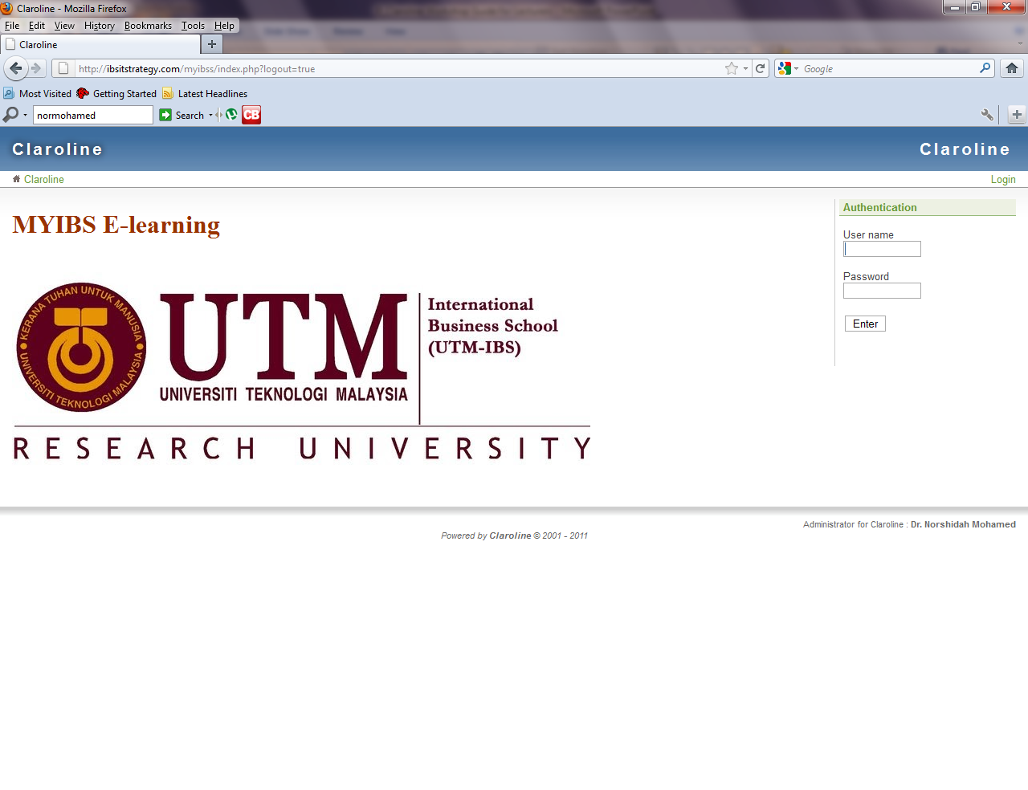
Main Page
User name: matrix number
Password: password. Click Enter.
Password is the IC no. at the back of your card OR password. It’s case-sensitive. If both don’t work for the first time only, please see Faridah at the IBS counter during office hours or e-mail her at nur312003@yahoo.com

Slide 4
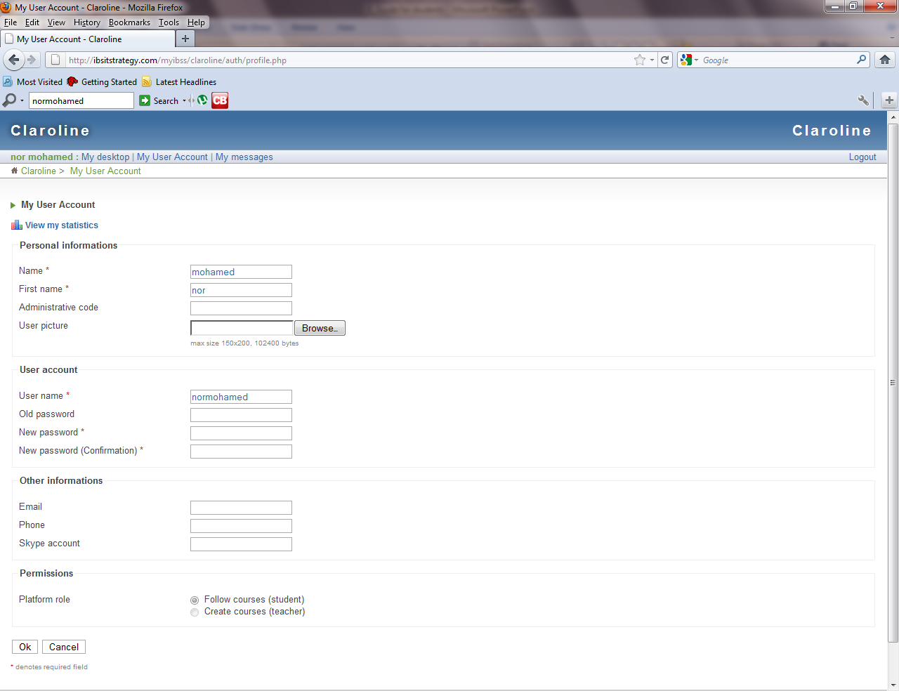
Change Password Page
To change your password, click My User Account. The page below appears and fill in your new password, new password confirmation, e-mail and phone number. Click OK. Then click My desktop on the left of the My User Account tab. Make sure e-mail is filled up. If you forget username or password later, MYIBS will send these to the e-mail you put here.

Slide 5
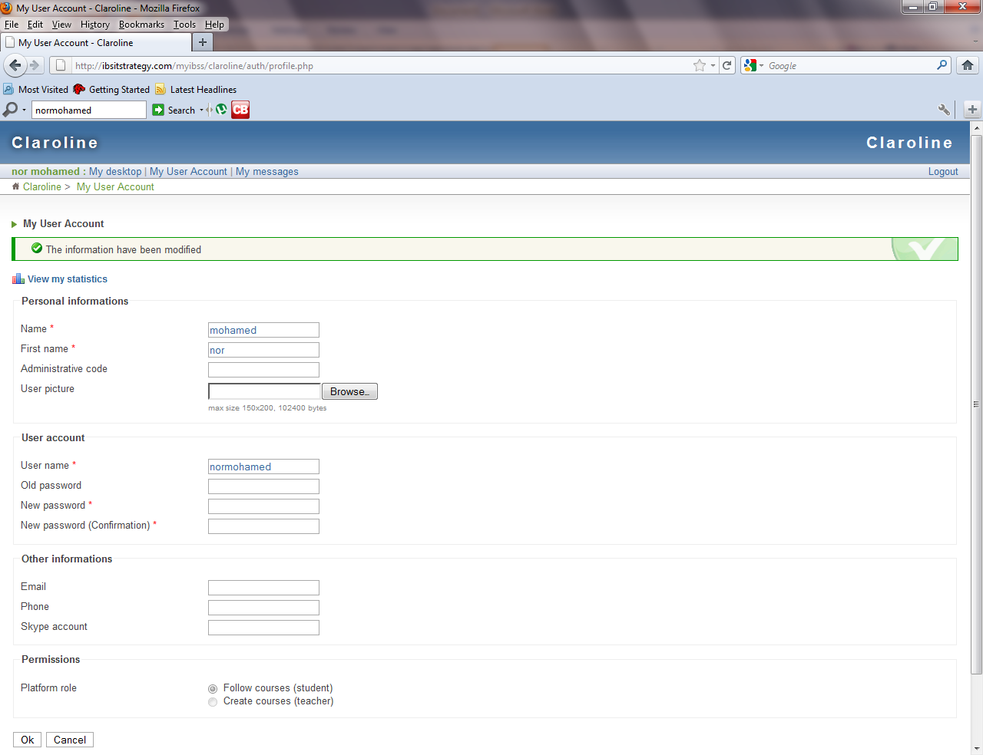
Message displayed changed information successful (green color text).
Now, click My desktop on the left of the My User Account tab.

Slide 6
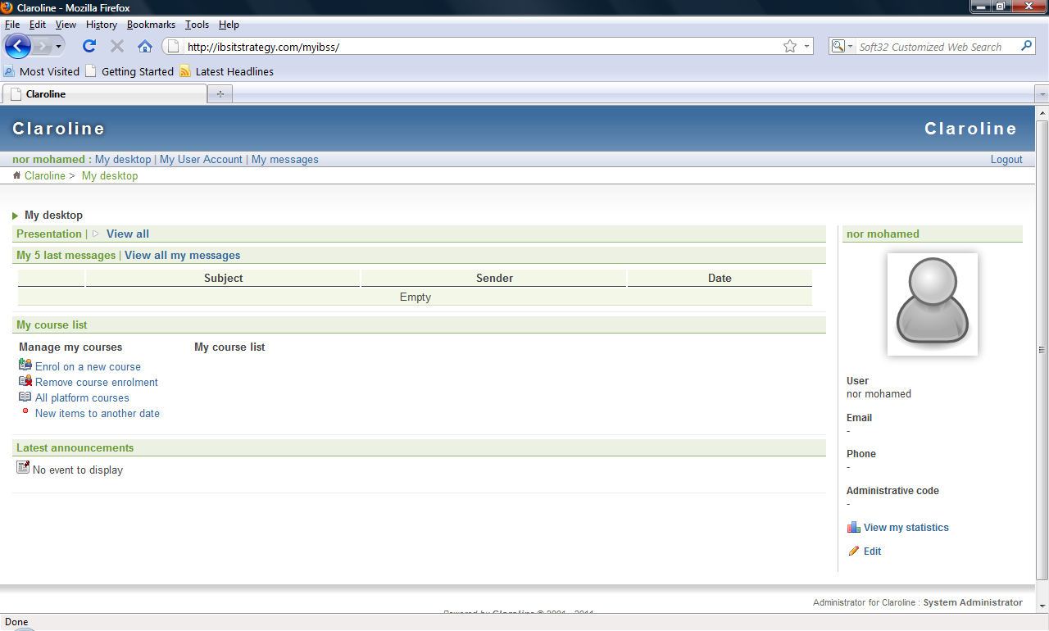
TO ENROL INTO A COURSE
1. Click enrol on a new course

Slide 7
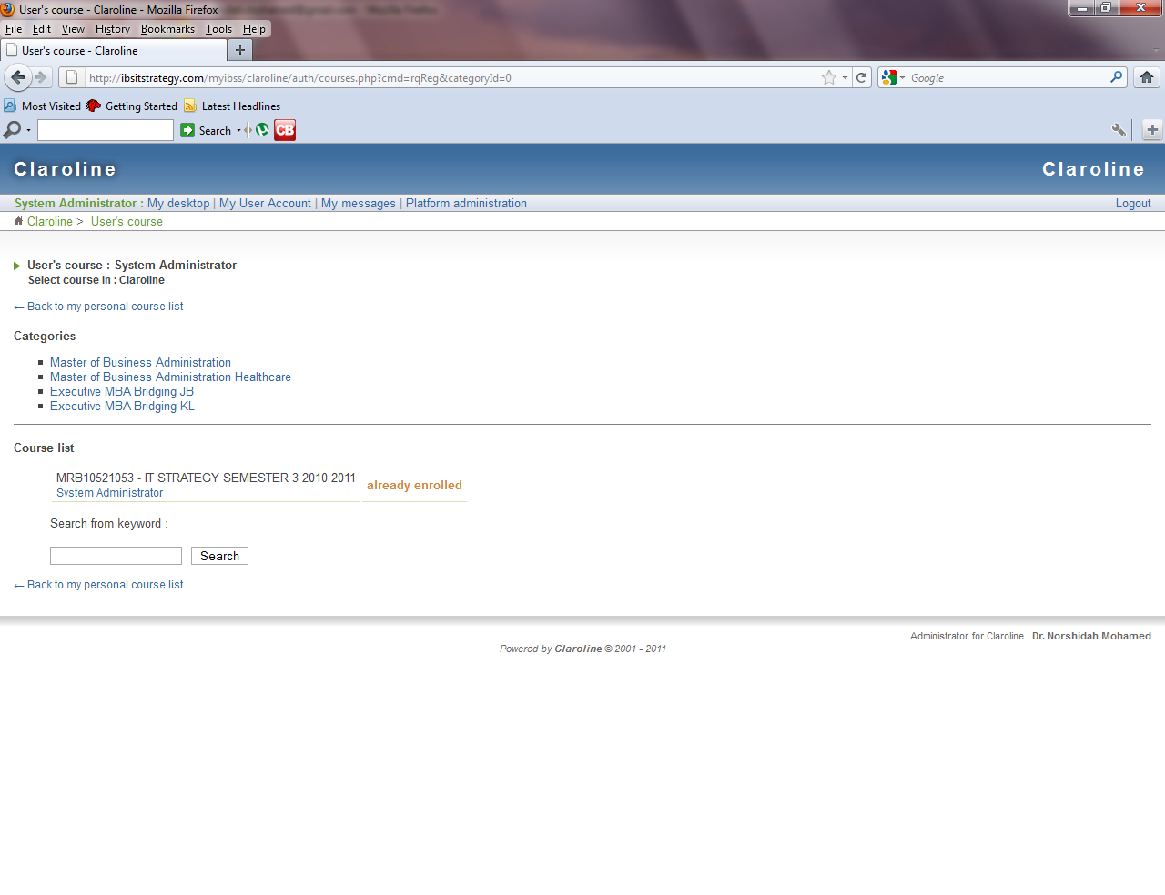
TO ENROL INTO A COURSE
2. Click program relevant to you

Slide 8
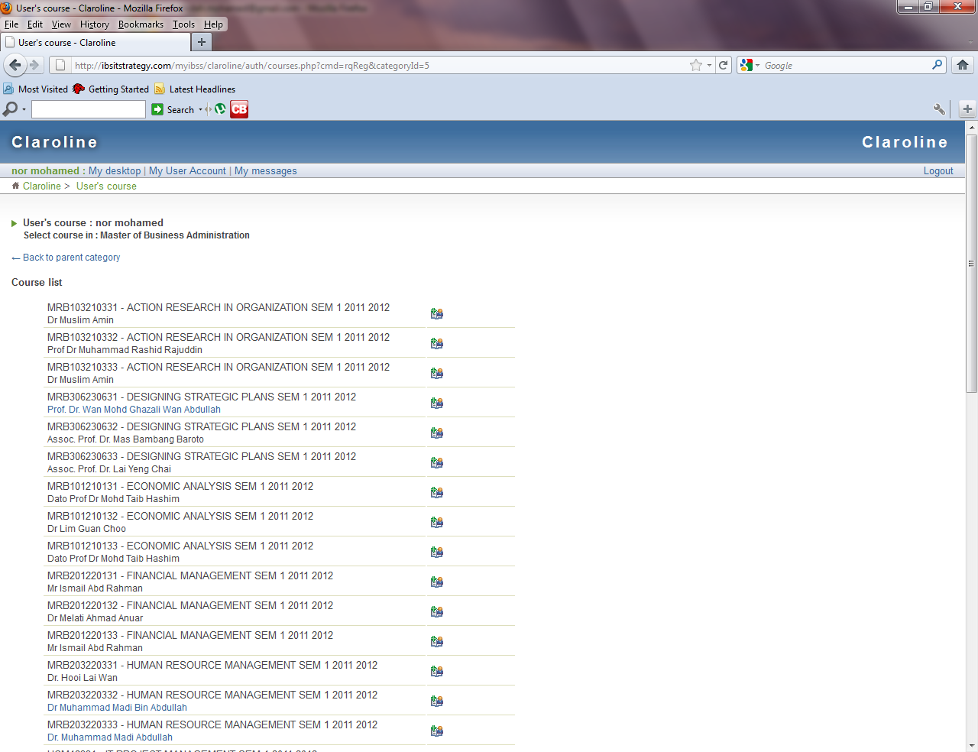
TO ENROL INTO A COURSE
3. Click the course that you want to enrol.

Slide 9
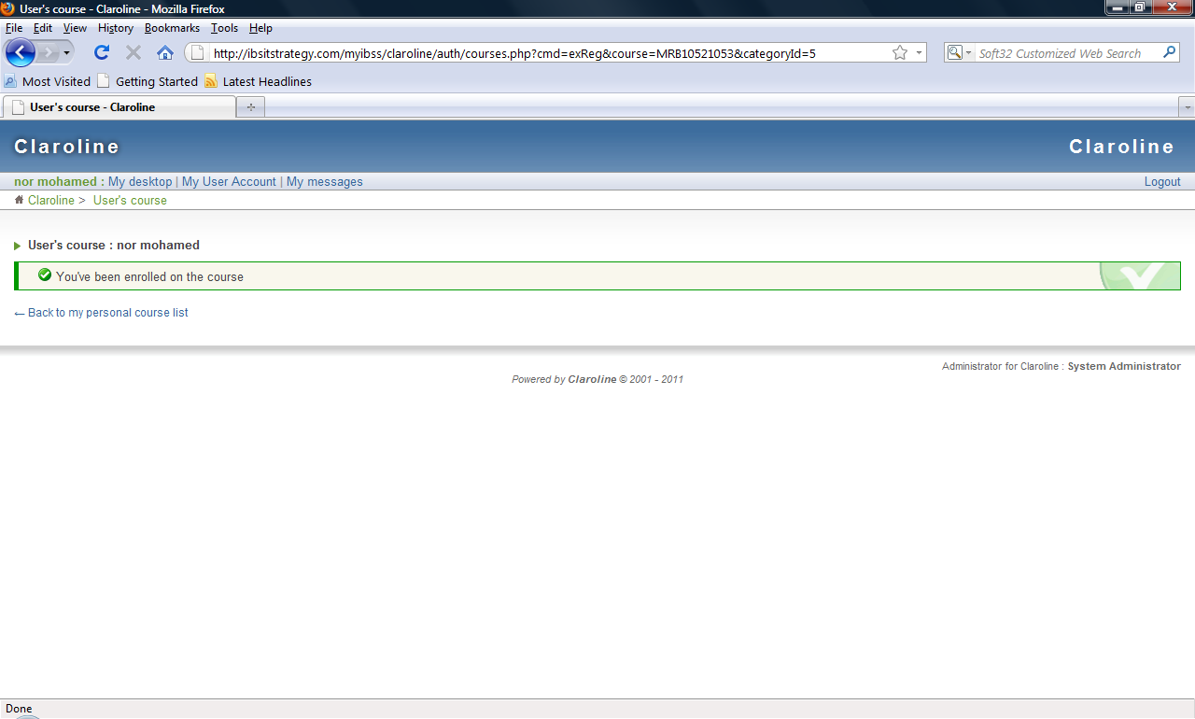
Message displaying successful enrolment
4. Click at desktop to check your enrolled course into the e-learning.

Slide 10
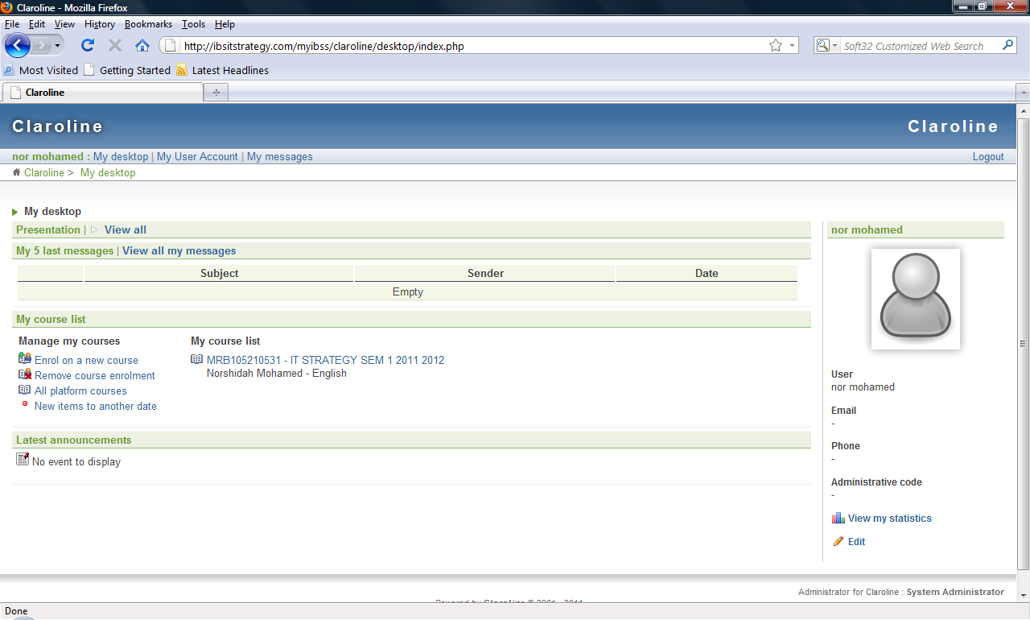
5. This is your already enrolled course. If you have registered for other courses, and want to enrol those in the e-learning, continue the previous steps by clicking the Enrol on a new course button on your left. When you click at the already enrolled course, you’ll be directed to the next page.

Slide 11
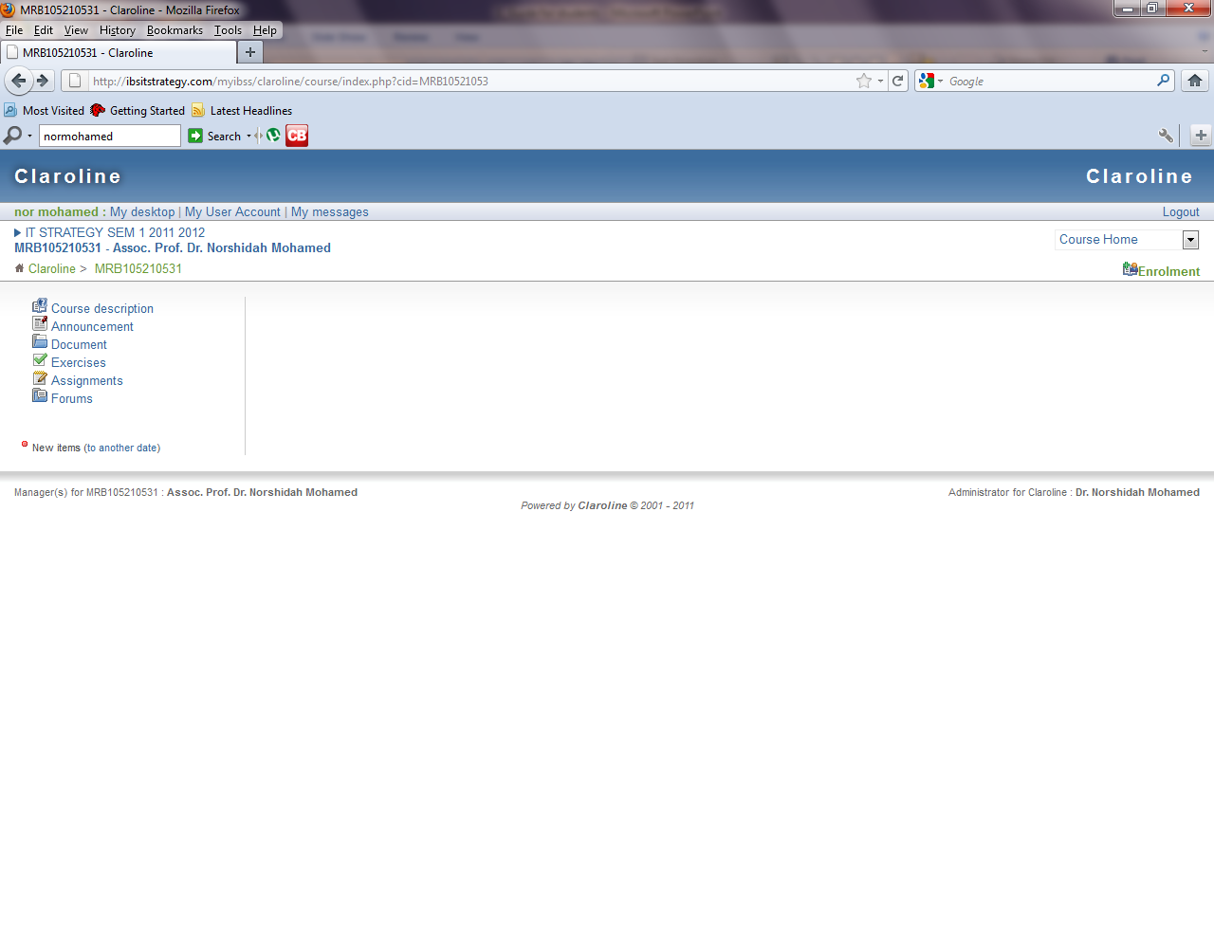
5. This is the interface where your instructor will announce important notices (Announcement link), upload lecture notes / slides (Document link), create discussion exercise (Exercise link), require you to submit soft copy term papers etc. (Assignment link) and create virtual discussion sessions on exams or case studies (Forum link)

Slide 12
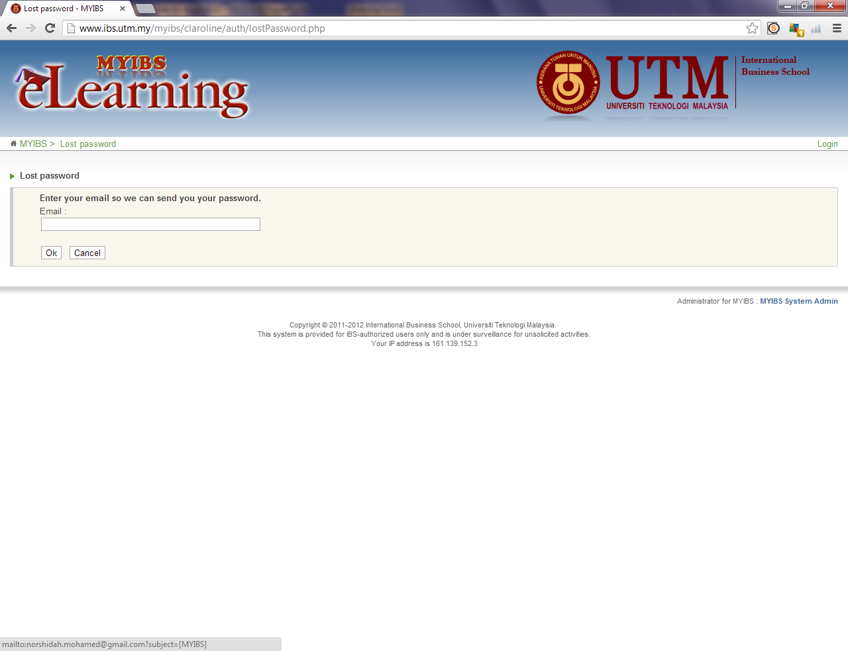
FOR SUPPORT
Type your email address
that you use when
registering to MYIBS earlier
Lost Password or reset

Slide 13
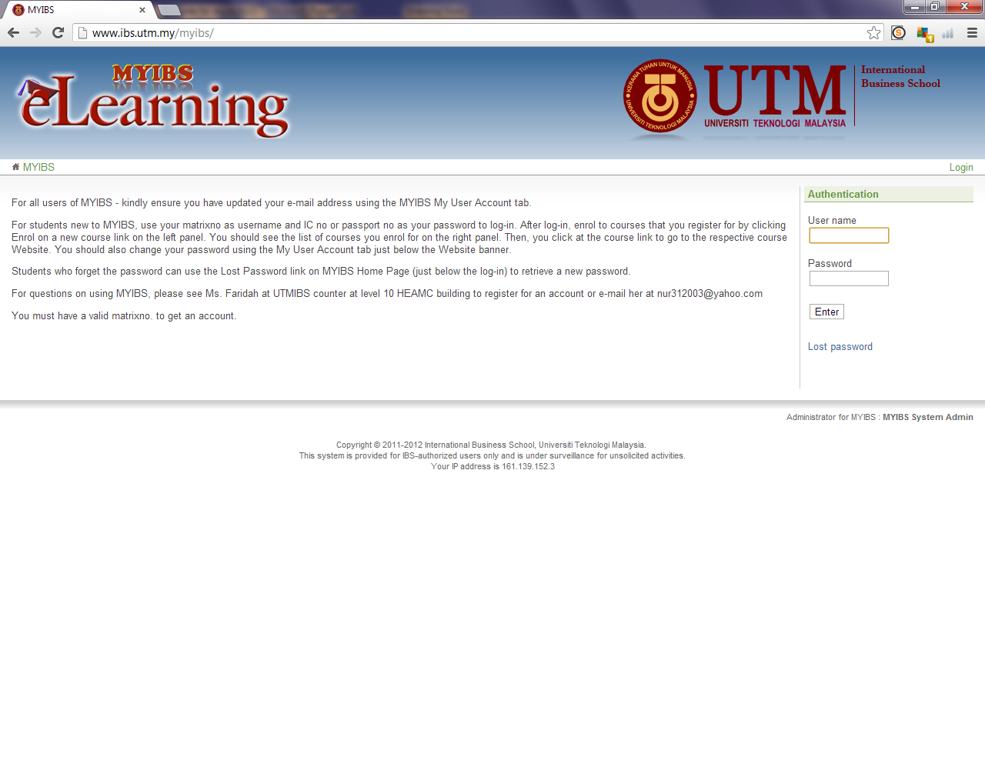
FOR SUPPORT
Click here and type
your email address
That you use when
Registering to MYIBS
Lost Password or reset

Slide 14
THANK YOU
Online Course Repository System using Claroline
For IBS Students Only

